Slide 1
End – Behavior Asymptotes
Going beyond horizontal Asymptotes

Slide 2
We will..
Learn how to find horizontal asymptotes without simplifying.
Learn how to find an oblique asymptote.
Learn how to find x-intercepts.
Utilize our knowledge to graph rational functions.

Slide 3
An end-behavior asymptote is an asymptote used to describe how the ends of a function behave.
It is possible to determine these asymptotes without much work.
Rational functions behave differently when the numerator isn’t a constant.
There are two types of end-behavior asymptotes a rational function can have:
(1) horizontal
(2) oblique

Slide 4
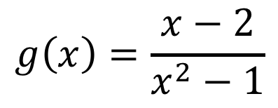
Graph the following functions in Desmos.
Estimate their end-behavior asymptote.
What do you notice about the highest degree terms in the numerator and denominator for every function?
Look at g(x) and n(x). What do you notice about the graph and the numerator?
These ALL have horizontal asymptotes of 0.
The numerator will give you the x-intercept after the rational function is simplified.
$$g\left(x\right)=\frac{x−2}{x^{2}−1}$$
$$h\left(x\right)=\frac{x+6}{x^{2}−2x−8}$$
$$f\left(x\right)=\frac{−3x^{2}+x+12}{x^{3}−4}$$

Slide 5
So far we have learned…
If n < m, then the end behavior is a horizontal asymptote y = 0.
After you simplify the rational function, set the numerator equal to 0 and solve. The solutions are the x-intercepts.
$$f\left(x\right)=\frac{a_{n}x^{n} + a_{n−1}x^{n−1} +…{+ a_{1}x^{1} + a}_{0}x^{0}}{b_{m}x^{m} + b_{m−1}x^{m−1} +…{+ b_{1}x^{1} + b}_{0}x^{0}}$$
Look at the leading term for the numerator and the denominator.

Slide 6
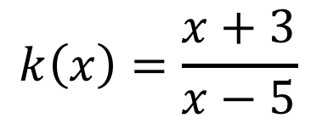
Graph the following functions in Desmos.
Estimate their end-behavior asymptote.
What do you notice about the highest degree terms in the numerator and denominator for every function?
What do you notice about the coefficients of the highest degree term in every function?
These ALL are horizontal asymptotes using the quotient of the leading coefficients.
$$k\left(x\right)=\frac{x+3}{x−5}$$
$$g\left(x\right)=\frac{2x^{2}+x−2}{x^{2}−1}$$
$$h\left(x\right)=\frac{x^{2}−x−2}{x^{2}−2x−8}$$
$$f\left(x\right)=\frac{−3x^{2}+x+12}{x^{2}−4}$$

Slide 7
So far we have learned…
If n < m, then the end behavior is a horizontal asymptote y = 0.
If n = m, then the end behavior is a horizontal asymptote $y=\frac{a_{n}}{b_{m}}$.
After you simplify the rational function, set the numerator equal to 0 and solve. The solutions are the x-intercepts.
$$f\left(x\right)=\frac{a_{n}x^{n} + a_{n−1}x^{n−1} +…{+ a_{1}x^{1} + a}_{0}x^{0}}{b_{m}x^{m} + b_{m−1}x^{m−1} +…{+ b_{1}x^{1} + b}_{0}x^{0}}$$

Slide 8
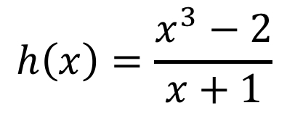
Graph the following functions in Desmos.
Estimate their end-behavior asymptote.
What do you notice about the highest degree terms in the numerator and denominator for every function?
What do you notice about the graphs of these functions?
These ALL are oblique asymptotes NOT horizontal.
We use long or synthetic division to find them.
$$k\left(x\right)=\frac{{4x}^{2}−3x−7}{2x+3}$$
$$g\left(x\right)=\frac{2x^{4}+x−2}{x−1}$$
$$h\left(x\right)=\frac{x^{3}−2}{x+1}$$
$$\left[−20, 20\right]x\left[−30, 30\right]$$
$$\left[−5, 5\right]x\left[−30, 30\right]$$
$$\left[−30, 30\right]x\left[−300, 500\right]$$
$$n\left(x\right)=\frac{x^{2}−x−2}{2x−8}$$
$$f\left(x\right)=\frac{−3x^{2}+x+12}{x−4}$$
$$\left[−20, 20\right]x\left[−30, 30\right]$$
$$\left[−30, 30\right]x\left[−250, 150\right]$$

Slide 9
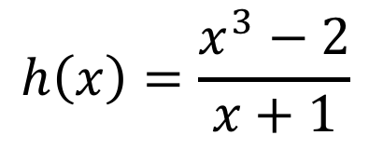
Let’s find the oblique asymptote using long division.
$$k\left(x\right)=\frac{{4x}^{2}−3x−7}{2x+3}$$
$$g\left(x\right)=\frac{2x^{4}+x−2}{x−1}$$
$$\left[−20, 20\right]x\left[−30, 30\right]$$
$$\left[−5, 5\right]x\left[−30, 30\right]$$
$$n\left(x\right)=\frac{x^{2}−x−2}{2x−8}$$
$$h\left(x\right)=\frac{x^{3}−2}{x+1}$$
$$\left[−20, 20\right]x\left[−30, 30\right]$$
$$\left[−30, 30\right]x\left[−300, 500\right]$$
$$f\left(x\right)=\frac{−3x^{2}+x+12}{x−4}$$
$$\left[−30, 30\right]x\left[−250, 150\right]$$

Slide 10
So far we have learned…
If n < m, then the end behavior is a horizontal asymptote y = 0.
If n = m, then the end behavior is a horizontal asymptote $y=\frac{a_{n}}{b_{m}}$.
If n > m, then the end behavior is an oblique asymptote and is found using long/synthetic division.
After you simplify the rational function, set the numerator equal to 0 and solve. The solutions are the x-intercepts.
$$f\left(x\right)=\frac{a_{n}x^{n} + a_{n−1}x^{n−1} +…{+ a_{1}x^{1} + a}_{0}x^{0}}{b_{m}x^{m} + b_{m−1}x^{m−1} +…{+ b_{1}x^{1} + b}_{0}x^{0}}$$

Slide 11
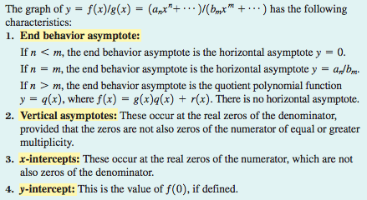
Here’s a synopsis of rational functions:

Slide 12
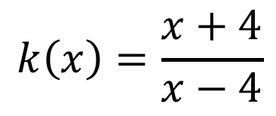
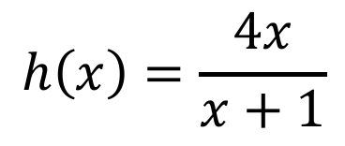
Practice
$$f\left(x\right)=\frac{x+6}{x^{2}+7x−6}$$
Domain
Range
Vertical asymptote(s)
Holes
Horizontal or oblique asymptote
X-intercept(s)
Y-intercept(s)
Does the function cross the horizontal or oblique asymptote?
$$g\left(x\right)=\frac{−x}{x^{2}−4x}$$
$$h\left(x\right)=\frac{4x}{x+1}$$
$$k\left(x\right)=\frac{x+4}{x−4}$$

Slide 13
Let’s review thus far..
How do you find horizontal asymptotes without simplifying?
How do you to find an oblique asymptote of a rational function?
How do you find x-intercepts of rational functions algebraically?
Summarize the general process of graphing a rational function.

Slide 14
Mathia time Keep your notes and Mathia notebook out.

